Slide 1
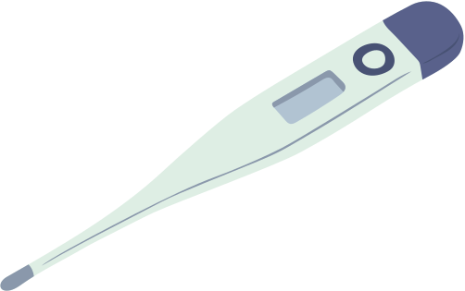



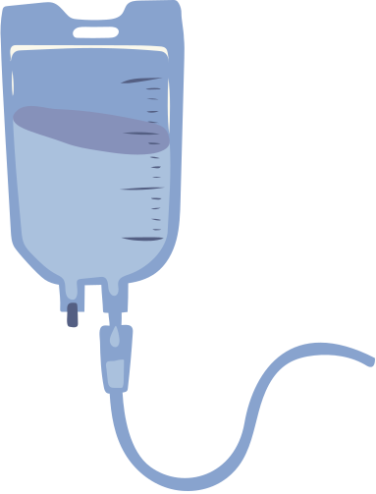




MENTORNESS PROJECT
DISEASE PREDICTION
By,
Lekshmi L

Slide 2



CONTENTS
DATASET ANALYSIS
DATA PREPROCESSING
MODEL BUILDING
METRICS EVALUATION
ROC CURVE
WHY GAUSSIAN NB?

Slide 3


DATASET ANALYSIS
we have access to a dataset containing multiple
health-related attributes such as cholesterol levels, blood cell counts, hormone levels, and other
physiological measurements. The dataset also includes information on whether the individual has been
diagnosed with a specific disease or not.
Objective: Predict whether a patient is diseased or healthy based on various medical features.
Libraries Import:
Pandas: Used for data manipulation and analysis.
Scikit-learn: A machine learning library for Python.
StandardScaler: For data preprocessing
Metrics (accuracy_score, precision_score, recall_score, f1_score): Used to evaluate the performance of the classification model.

Slide 4

DATA PREPROCESSING
Loading and Cleaning the Data:
Load data from CSV files using Pandas.
Drop rows with missing values to ensure the quality of the dataset.
Dropping missing values: Ensures that the dataset is complete and no calculations are based on incomplete data, which could bias the results.

Slide 5

MODEL BUILDING
2. Converting to Binary Classification:
Convert the target variable to binary: 0 for 'Healthy', 1 for other diseases.(Multiclass problem)
1. Splitting Features and Target Variable:
Separate features (X) and target variable (y) for both training and testing datasets.
Standardize the features to have a mean of 0 and a variance of 1, which is a requirement for Gaussian Naive Bayes.
3. Training the Model:
Train the Gaussian Naive Bayes model using the training dataset.

Slide 6

METRICS EVALUATION
Accuracy: Measures the overall correctness of the model.
Precision: Measures the correctness of positive predictions.
Recall: Measures the ability of the model to capture all positive instances.
F1 Score: Harmonic mean of precision and recall, providing a single metric
that balances both concerns.
Prediction and Evaluation:
Predict the labels for the test data.
Evaluated the model using various metrics: Accuracy, Precision, Recall, and F1 Score.
Accuracy: 0.9465020576131687
Precision: 0.9934924078091106
Recall: 0.9521829521829522
F1 Score: 0.9723991507430998
ACCURACY:
94%
PRECISION:
99%
RECALL:
95%
F1 SCORE:
97%

Slide 7
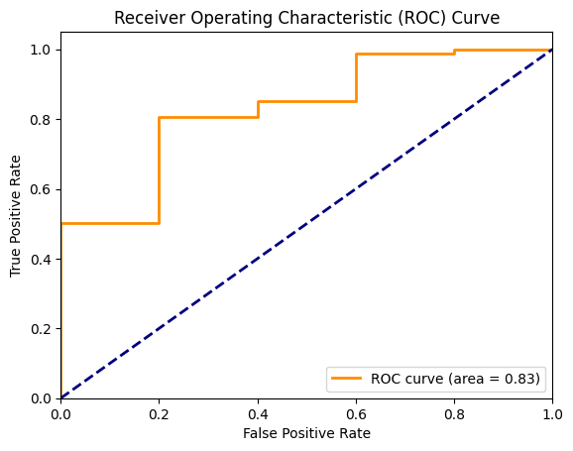
ROC CURVE
The ROC curve showed a good balance between sensitivity (true positive rate) and specificity (false positive rate).
The area under the curve (AUC) is 0.83, indicating that the model has a strong ability to distinguish between diseased and non-diseased individuals.
An AUC of 0.83 suggests that the model is performing well, with a high probability that it will correctly classify a randomly chosen positive instance over a randomly chosen negative instance.

Slide 8

Why GaussianNB for Medical Dataset?
Suitability for Medical Data: Medical datasets often involve normally distributed features, making Gaussian Naive Bayes a good fit.
Performance: Despite its simplicity, GaussianNB can provide good performance for binary classification tasks, especially when the assumption of feature independence holds approximately true.
Efficiency: Naive Bayes classifiers are fast and require less training data, making them suitable for large datasets with many features.

Slide 9
Thank you

